Slide 1
Collective Impact Approach in Community Development A Case study of the APSC Environment Track
4th IAVE Africa Regional Conference – Rwanda
June 8-11, 2015
Presentation by:
Daniel Omondi Juma
Executive Director
Global Peace Foundation, Kenya

Slide 2
What is Collective Impact Approach?
Premised on the belief that no single policy, government department, organisation or program can tackle or solve complex social problems we face as a society.
Multiple organisations or entities from different sectors abandon their own agenda in favour of a common agenda, shared measurement and alignment of effort.
Collective Impact initiatives have centralised infrastructure – known as a backbone organisation – with dedicated staff whose role is to help participating organisations shift from acting alone to acting in concert.

Slide 3
Key Elements
Common Agenda
Common Progress Measures
Mutually Reinforcing Activities
Communication shows culture of collaboration
Backbone Organization to manage the Collaboration

Slide 4
Examples
Global Peace Convention in Nairobi 2010 brought together 40 countries with a common goal of finding solutions to peace and regional integration.
Africa Conference on Volunteer Action for Peace & Development in Nairobi 2012, brought together Youth, UN Agencies, AU, RECs, Government Agencies, CSOs & Private Sector and launched APSC
APSC Environment Track brings together Government, 10 private sector foundations, CSOs, youth serving organizations and youth

Slide 5
The Environment Track
Launched in July 2012 at the UN Headquarters Nairobi at the Africa Conference on Volunteer Action for Peace & Development
Engages Government, UN agencies, civil society, youth organizations and private sector partners to provide a platform for youth in the informal sector to earn a living from solid waste and reforestation
Contributes to achievement of 10% forest cover in Kenya as envisioned in Vision 2030

Slide 6
“This consortium is a first in Kenya where many corporates are working together to support one joint program, through the shared value approach”
Les Baillie, the Executive Director of M-PESA Foundation
and Chair of the Environment Track

Slide 7
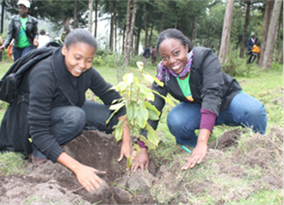
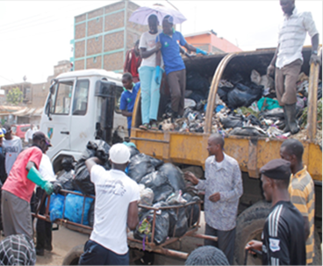
Areas of Focus
Water Harvesting
The Greening Initiative
Reforestation & Waste Management

Slide 8
Current Reforestation Initiatives
Partnership with Government and private sector to launch Nelson Mandela Forest
Government has allocated land in Ngong Forest near Nairobi for the launch
Two extra sites identified for Wangari Maathai and Manu Chandaria Forests
Community youth volunteer groups will maintain the forests

Slide 9
The Greening Initiative
Involves in school and out of school youth volunteers
Over 1000 trees planted during the 2013 World Environment day by 200 volunteers
East African Breweries (EABL) Foundation supporting planting of 40,000 trees at a cost of $20,000
Unilever supporting Kinale Forest restoration with $5,000

Slide 10
The Community Cooker
Aimed at promoting the adoption of appropriate technology in solid waste management
Build entrepreneurship culture among the youth
Mainstreaming environmental stewardship to improve livelihoods of at least 1,000 households in Kariobangi slums, Nairobi
11 youth groups have come together to set up a commercial enterprise to run the project

Slide 11
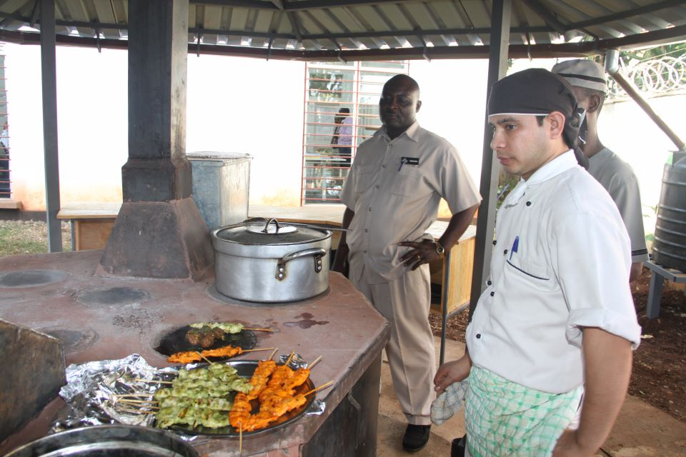
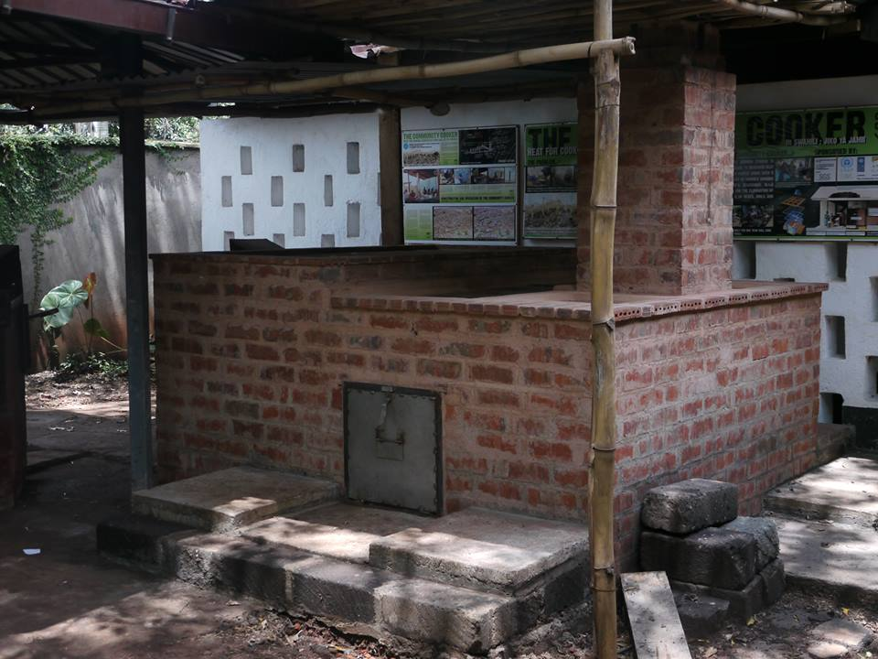
An incinerator which burns all forms of waste
Energy is harnessed for useful purposes; (cooking, steam generation, electricity generation, etc)

Slide 12
Key Component of the Cooker
Capacity Building
Waste Management
Entrepreneurship
Leadership
Business Model
Cafeteria
Cyber Café
Sanitation Block
Community Mobilization

Slide 13
TRANSFORMING EDUCATION
Public – private partnerships working to make education relevant to 21st century demands
GPF collaborating with the Ministry of Education, Samsung C & T, Community Chest of Korea, Airtel, Chandaria Foundation, Intel Corporation, Cisco Inc. and UN Habitat to nurture innovation in high school
Diverse membership in the National Committee on Transforming Education in Kenya

Slide 14
Partners

