Slide 1




4th IAVE Africa Regional Conference – Rwanda
June 8-11, 2015
GPLC East Africa
July 21-24, 2015
“Promoting Peace, Security and Sustainable Development in the East Africa Region: A Call to Moral and Innovative Leadership”
Presentation by:
Daniel Omondi Juma Executive Director
Global Peace Foundation, Kenya

Slide 2
Kick-off Meetings
GPF TEAM MEETS WITH PRESIDENT KARUME IN ZANZIBAR: The co-chair, GPLC East Africa

Slide 3
Kick-off MISSION
With Archibishop Eliud Wabukala,
Head of the Anglican Church, Kenya
With Ambassador Amina Mohamed,
Foreign Affairs Cabinet Secretary, Kenya

Slide 4
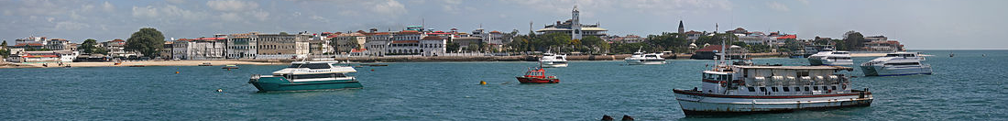
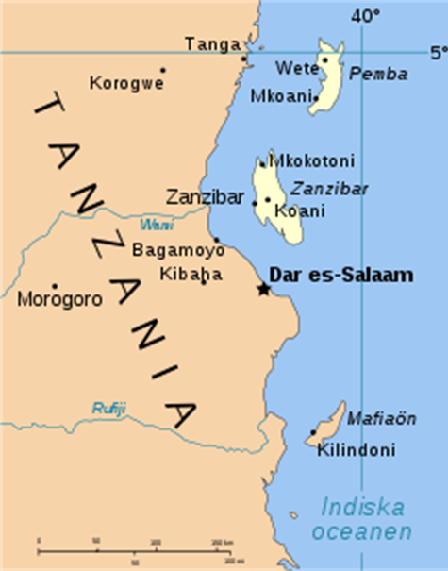
Semi-autonomous with own government-Revolutionary Government of Zanzibar
Total Population 1.3 million (world population review 2014)
Zanzibar island is 85 km long & 39 km wide (1,464 km² )
Pemba island is 67 km long & 23 km wide (985 km²)
99% people are Muslim 1% are Christian
Major economic sectors: Agriculture, Trade and Industries and Tourism

Slide 5
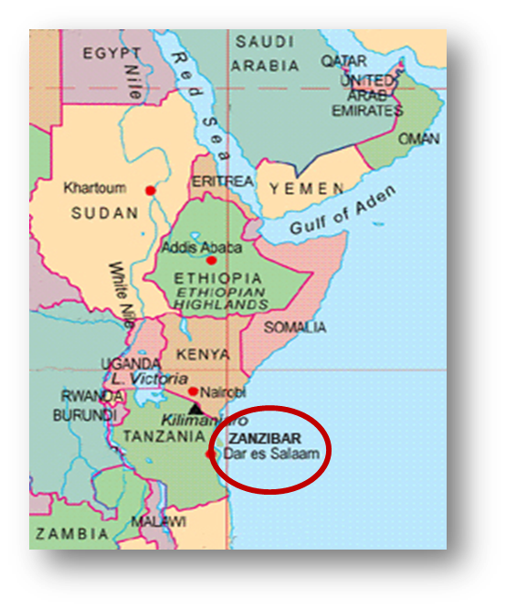

Zanzibar
East Africa-Middle East Bridge
Former Capital of the Oman Sultanate with Arabic-Swahili Culture
Islam introduced into Africa through Zanzibar
Warm ties with all Arab & East African Nations
Front-Line Location Addressing Interfaith in the Region

Slide 6
GPLC 2015 STRATEGIC AIM
GPF and its partners recognize that alleviating poverty and moving toward economic prosperity can only be achieved if peace and security are established throughout the region.
GPLC 2015 East Africa therefore will focus on:
Moral and innovative leadership
Identity-based conflict reduction with interfaith partnerships
Youth entrepreneurship, leadership, and service

Slide 7
GPLC East Africa Objectives
Prevent identity-based violence through interfaith vision & partnerships based on universal principles & values
Engage East Africa youth in moral and innovative leadership, entrepreneurship and service
Launch of the Africa Presidential Mission, led by former Zanzibar President Amani Karume
Forge new partnerships to sustain ongoing youth and interfaith initiatives over next three years
With the Mufti Secretary of Dar es salaam

Slide 8
KEY RESULTS ANTICIPATED
Improved interfaith collaboration that will mitigate identity-based violence and extremism
Regional partnership linkages between East Africa & Middle East nations for strategic cooperation in peace-building, combating extremism, trade & development
Increased commitment to regional stability and economic progress that empowers young leaders
Enhanced contributions to regional integration and progress toward peace and sustainable development by young leaders

Slide 9
GPF Track Record and Capabilities
Working with COMESA to empower youth in moral leadership, peace-building, good governance
Interfaith peace building with youth & faith leaders in Kaduna and other conflict-ridden Nigerian states
Working with global partners in the Middle East
2013: convened Global Peace Leadership Conference in Abuja, with faith leaders including the Catholic Cardinal and Sultan of Sokoto
2012: GPF and United Nations Office in Nairobi, launched the East Africa Peace Service Corps with over 35 partners
2010: Co-convened with Kenya Government Global Peace Convention with leaders of 40 nations -Nairobi Declaration for Peace Building

Slide 10
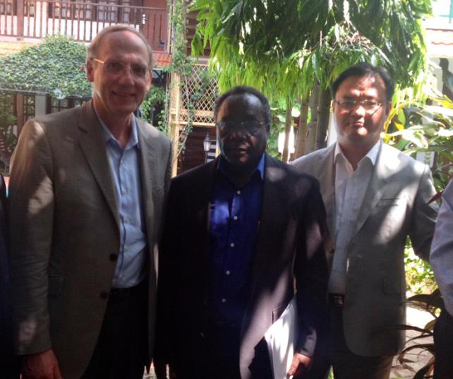
PARTNERS
Government and relevant ministries of Zanzibar
Government and relevant ministries of Tanzania
East Africa Community
Cloud FM
Inter-Religious Council for Peace Tanzania
Mohamed Enterprise
COMESA and IGAD
East Africa Business Council
Indian Ocean Commission
Bakhresa Group
Many others…

